Slide 1

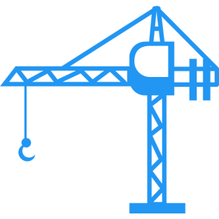

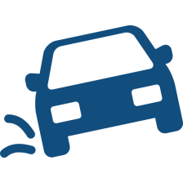

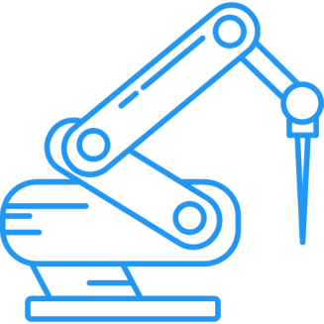



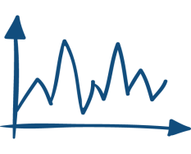
optimization
feedback control
robustness
learning control
model identification

Slide 2
Converged error
an optimal
compromise solution
Convergence speed

Slide 4

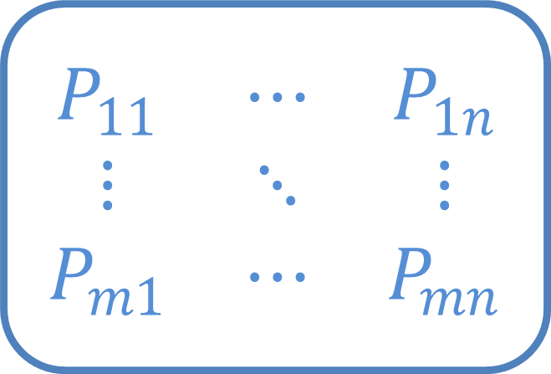

$$\begin{matrix}P_{11} & ⋯ & P_{1n} \\ ⋮ & ⋱ & ⋮ \\ P_{m1} & ⋯ & P_{mn}\end{matrix}$$
$$⋮$$
$$⋮$$
MIMO system

Slide 5
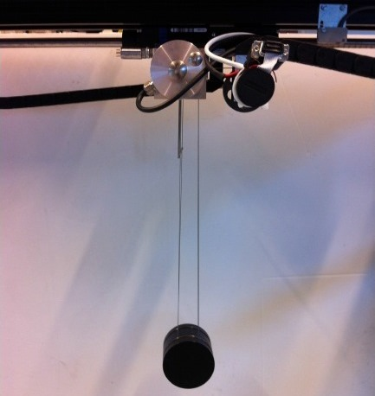

Slide 6
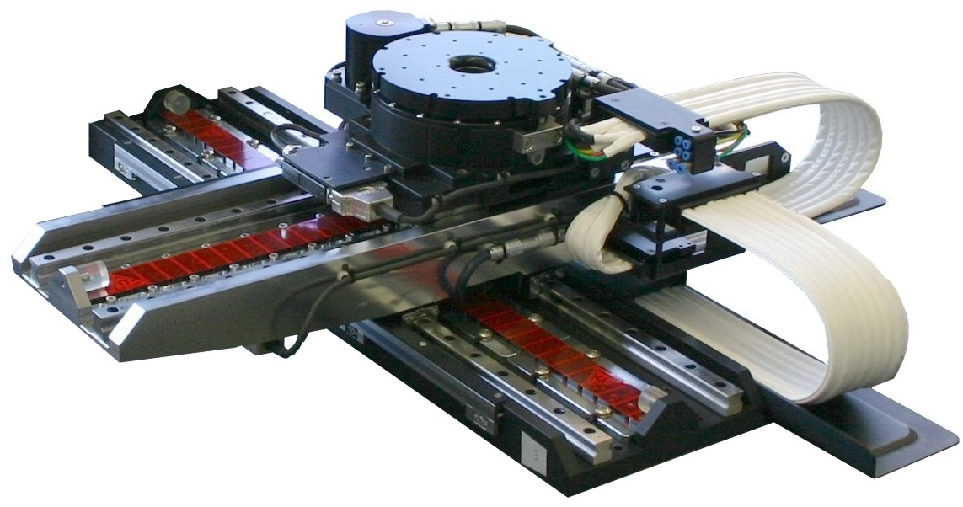

Slide 7
Iterative Learning Control
Iterative learning control (ILC) is widely used in control applications to improve performance of repetitive processes. Examples of ILC applications are: industrial robots (i.e. pick-and-place robots, gantry robots, cutting robots), motion systems (wafer stage, medical rehabilitation equipment…), batch processes (chemical processes, rapid thermal processing). The key idea of ILC is to update the control signal iteratively based on measured data from previous trials, such that the output converges to the given reference trajectory.

Slide 8
In norm-optimal ILC, the input signal for the next trial is generated by solving an optimization problem. This approach can deal with input constraints efficiently. The cost function of the optimization problem relies on the system model, hence model uncertainty can cause divergence and/or degrade the performance of norm-optimal ILC. To deal with this problem, we propose a robust worst-case norm-optimal ILC design, where model uncertainty is taken into account. The design problem is reformulated as a convex optimization problem, and can be solved efficiently to obtain the updated input signal.

